Slide 1
Describing Data
© McGraw Hill LLC. All rights reserved. No reproduction or distribution without the prior written consent of McGraw Hill LLC.

Slide 2
The Problem
A data set is a “bunch of numbers”
Statisticians say we must "let the data talk"
But how do we give data a voice?
We want the main features of the data
But how to omit less important details?

Slide 3
The Solution
We have many tools to explore data
We can use more than one tool
Visual displays are more vivid
Software makes it easier

Slide 4
Tools of Data Analysis
Tool | What Is It? | What It Shows | Pro/Con
Dot plot | Each dot is an observation plotted on X axis | Data range, modes, general shape | Simple and intuitive and shows all the data
Stem-and-leaf | Frequency tally using data values for stem and leaves | Data range, frequencies, shape | Retains raw data but awkward unless you have 2-digit data
Histogram | Frequency tally of data in bins based on X values | Shape, modal classes | Number of bins and bin limits affect apparent shape
Box plot | Five-number summary: X_{min}, Q₁, Q₂, Q₃, X_{max} | Range, quartiles, skewness | Intuitive, but requires fences to reveal outliers
Numerical statistics | Mean, median, quartiles, standard deviation, etc. | Central tendency, dispersion, shape | Precise, but not as easy to digest visually

Slide 5
Example
How long do justices serve on the U.S. Supreme Court? They are appointed for life or until they retire. From 1789 to 2016 there were 107 justices who had completed their terms (shown below in order of year appointed).

Slide 6

Dot Plot
The dot plot is attractive because it does not "bin" the data very much. You can "see all the data" in a dot plot. It is basically a one-dimensional scatter plot.
Interpretation: The range is 1 to 36. There's a mode at 5 years, but other modes also exist. Right-skewness is suggested.
Note: Excel does not offer a stem-and-leaf. This is from MegaStat.

Slide 7
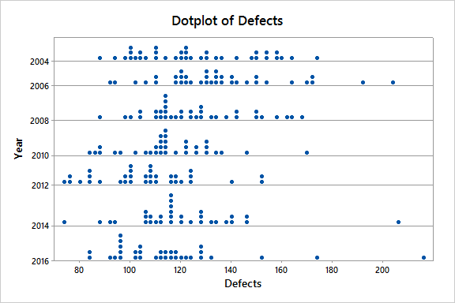
Stacked Dot Plot
Stacked dot plots are useful to compare groups visually.
Note: Excel does not offer dot plots. This is from Minitab.

Slide 8
Stem-and-Leaf
The stem is the first digit. The leaf shows the second digits. It resembles a frequency tally showing digits shown instead of tally marks. In this example, modal service is 0-9 years, while 10-19 years is almost as common.
Interpretation: In this example, modal service is 0-9 years, but 10-19 years is almost as common.
Note: Excel does not offer a stem-and-leaf. This is from MegaStat.

Slide 9
Stem-and-Leaf
For 2-digit data in a large sample, we can split the stem into low and high values (8 categories) if the single stem (4 categories) doesn't show enough detail or produces long strings of characters.
Interpretation: We see three modal classes at 5-9, 15-19, and 30-34.

Slide 10
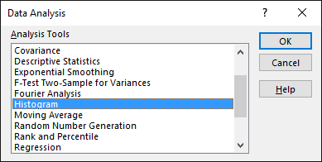
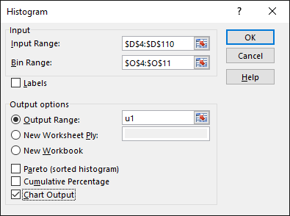
Excel Histograms
Tip: Excel makes histograms, but they are awkwardly labeled. They can, however, be edited and improved.

Slide 11

Binning
10 bins
Using 10 bins we see several modal classes.
4 bins
Using 4 bins the data appear more right-skewed.
Note: The number of classes and choice of class limits will affect a histogram's appearance. These were produced using Minitab.
Sturges' Rule suggests that a
good number of classes k is
k = 1 + log₂n
Here k = 1 + log₂(107) = 1+6.74 = 7.74 ≅ 8

Slide 12
Too Many Bins?
8 bins
Stuges’ Rule with bin width of 5. Three modal classes.
18 bins
Using 18 bin width of 2. Four modal classes
The logic of Sturges’ Rule is that the number of bins should reflect the information content of the sample. For more, see https://en.wikipedia.org/wiki/Information_theory.
Note: These histograms were created in Minitab.

Slide 13

Number of Bins
18 bins
10 bins
4 bins
2 bins
Too many bins – excessive info. Too few bins – insufficient info.
Note: These histograms were created in Minitab.

Slide 14
Other Frequency Displays
Frequency Polygon
Ogive
Empirical CDF
Polygon and ogive are from MegaStat using 8 bins. The Empirical CDF is from Minitab (individual data values and a fitted normal CDF).

Slide 15
Box Plot
The ends of the “whiskers” are the lowest and highest data values (1 and 36 years, respectively)., The ends of the box show the quartiles (25%, 50%, 75%).
Q₁
Q₂
Q₃
Interpretation: The "box" (interquartile range) is symmetric, although the long right tail suggests slight right-skewness. No outliers are seen.

Slide 16
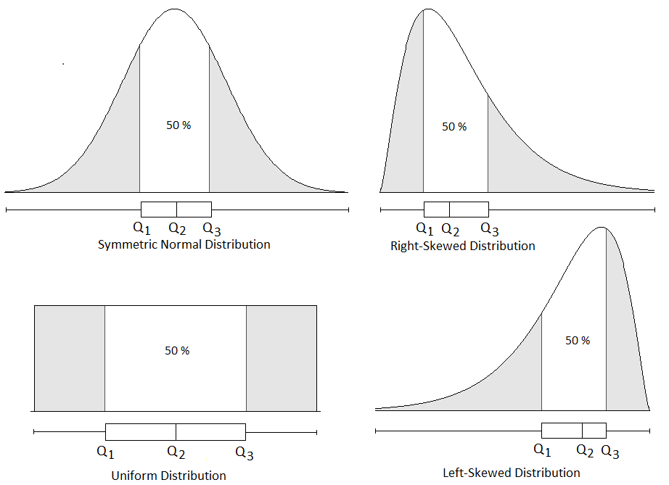
Box Plot
In a skewed distribution, the median Q₂ is not in the middle of the “box.” However, the “box” still demarcates the middle 50% and each tail contains 25% of the area.

Slide 17
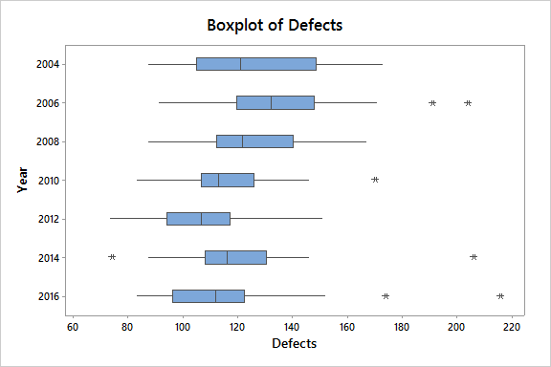
Stacked Box Plot
Boxplots can be useful to compare groups.
Note: This boxplot with groups was prepared using Minitab.

Slide 18
Excel Box Plot
Excel's default box plot puts the scale on the vertical axis. The interpretation is the same.

Slide 19
Numerical Statistics
Use intuitive formulas in Excel or R to calculate the statistics you need for data vectors x and y. Use them to create a custom data summary.
Descriptive Statistics | Excel Function | R Function
Number of data items | COUNT(x) | length(x)
Largest data value | MAX(x) | max(x)
Smallest data value | MIN(x) | min(x)
Mean | AVERAGE(x) | mean(x)
Median | MEDIAN(x) | median(x)
Geometric mean (positive data values) | GEOMEAN(x) | exp(mean(log(x)))
Average deviation around the mean | AVDEV(x) | mad(x)
Quartile k = 1, 2, 3 for 25%, 50%, 75% | QUARTILE.EXC(x, k) | quantile(x, p, type=6)
Percentile p e.g., p = .25 for 25% | PERCENTILE.EXC(x, p) | quantile(x, p, type=6)
Sample standard deviation | STDEV.S(x) | sd(x)
Sample covariance for (X,Y) data pairs | COVARIANCE.S(x, y) | cov(x, y)
Standardize an X value | STANDARDIZE(x, µ, σ) | (x-mean(x))/sd(x)
Correlation coefficient for (X,Y) data pairs | CORREL(x, y) | cor(x, y)
Tip: Google Sheets has the same formulas as Excel.

Slide 20
Numerical Statistics
Interpretation: The mean slightly exceeds the median, suggesting right-skewness. The interquartile range (middle 50%) is 7 to 23 years. The kurtosis statistic hints at a flatter-than-normal distribution, and the data do not conform well to the Empirical Rule for a normal distribution. There are no outliers.
Note: Table is from MegaStatTM.

Slide 21
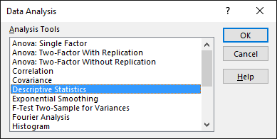
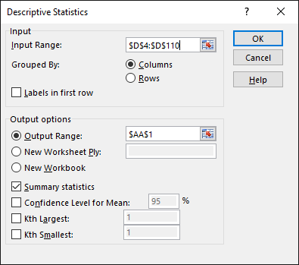
Excel Statistics
Note: Kurtosis and skewness statistics are adjusted for sample size and kurtosis statistic is centered at 0. Quartiles are not shown in Excel’s Descriptive Statistics.

Slide 22
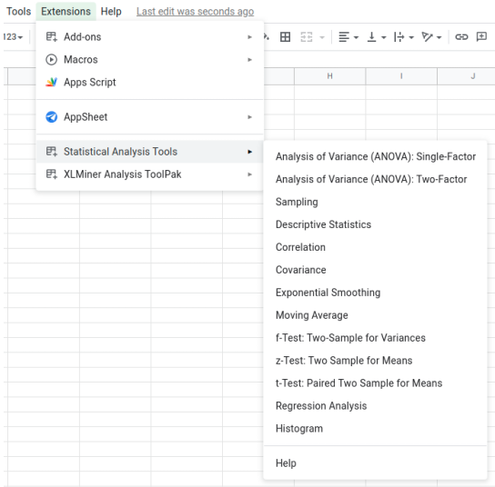
Google Sheets?
The Statistical Analysis Tools add-in resembles Excel’s Data Analysis, but you must pay a fee to activate it (unless your university or employer has obtained a license). Other add-ins (not free) such as XLMiner are also available in Google Sheets.

Slide 23
Standardizing
Tip: It is a good idea to sort the data and calculate a standardized z score for each data point.
Standardized Data:
z_{i} = (x_{i} – Mean) / StdDev
Interpretation: Three justices served 1 year (less than two standard deviations below the mean). The longest serving (Douglas at 36 years) is not an outlier (within three standard deviations of the mean).

Slide 24
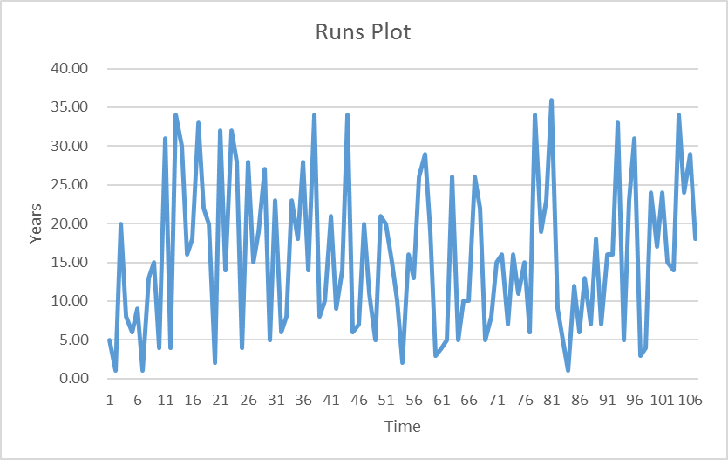
Runs Chart
A runs chart plots the data points in the same order they appear on the list, to look for trends or patterns.
Interpretation: A slight upward trend may exist years served by recent appointees, but there is much variation around the mean (15.86 years). This chart is from MegaStat.

Slide 25
Summary
The data would like to tell a story
Statistical tools let the data "talk" to us
Pictures may be better than numbers
There is no single "right" tool
Careful analysis requires several tools

